Slide 1
Project review ileen xaxa 22mcaa25

Slide 2
agenda
Introduction
Offer Letter
About the Company
Tasks
About the Project
Data set
Software tools
Case Study
Visualization of case study
Model and prediction
Conclusion
Ileen xaxa 22mcaa25

Slide 3
Introduction
Role: DATA ANALYST
At: Unified Mentor
Duration : 3 months
Ileen Xaxa 22mcaa25

Slide 4
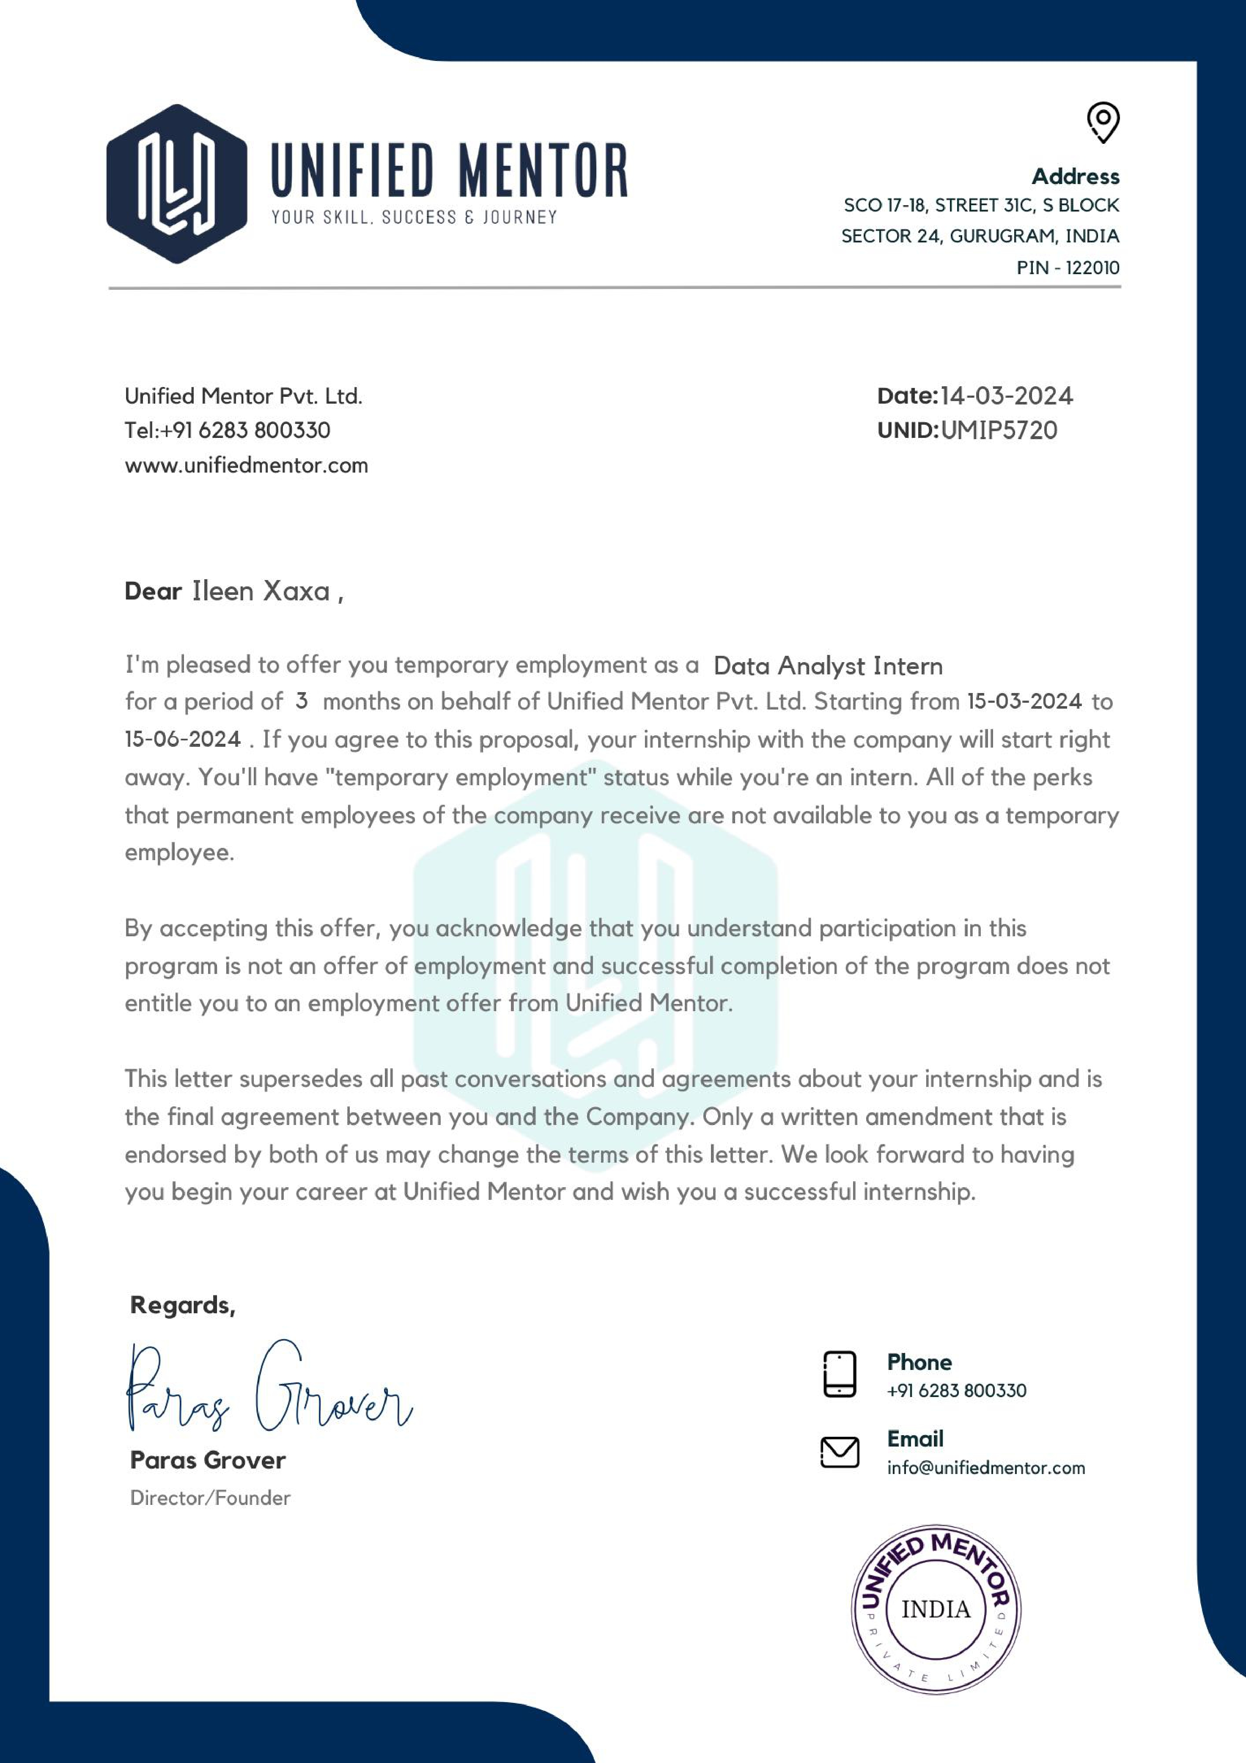
Offer letter

Slide 5
ABOUT THE COMPANY- Unified Mentor
Embark on an extraordinary odyssey of honing skills and propelling your career forward with us at Unified Mentor. Our purpose is clear and impactful: empowering individuals to bolster their employability through tailor-made skill enhancement initiatives.
At Unified Mentor, we're staunch advocates of personal evolution as the cornerstone of our shared triumphs. We eagerly seek out inventive, skilled individuals who thrive on challenges and pursue perfection. If you possess ambition and fervor for your aspirations, you're ideally suited to our mission of fostering Leadership through Global Talent Development.
Ileen xaxa 22mcaa25

Slide 6
TASKS
Training period- skills to be learned
Python- numpy, pandas
Tableau
Power bi
Statistics
Ileen xaxa 22mcaa25

Slide 7
Project
The problem is about bird strikes, which refer to collisions between birds and aircraft. Bird strikes are a significant threat to aircraft safety, causing damage to aircraft structures and potentially leading to loss of thrust in jet engines when birds are ingested into the engines. These incidents can occur at any flight phase but are most common during take-off, initial climb, approach, and landing due to higher bird activity at lower altitudes.
this project is crucial because it addresses a significant safety issue in aviation, offers the potential for economic savings, and contributes to the overall safety and efficiency of air travel through the application of advanced technologies and data analysis.
DATASET:
To have a closer look the following document visually depicts the data collected on Bird Strikes by FAA between 2000-2011.
Ileen xaxa 22mcaa25

Slide 8
Tools
Python
Excel
Power bi
Ileen xaxa 22mcaa25

Slide 9
Case studies
Yearly Analysis & Bird Strikes in the US
Top 10 US Airlines in terms of having encountered bird strikes
Yearly Cost Incurred due to Bird Strikes:
When do most bird strikes occur?
Phase of flight at the time of the strike.
Effect of Bird Strikes & Impact on Flight
Were Pilots Informed? & Prior Warning and Effect of Strike Relation
Ileen xaxa 22mcaa25

Slide 10
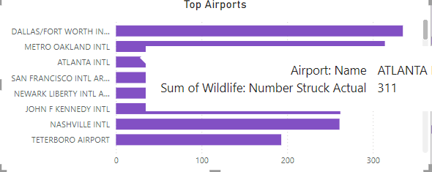
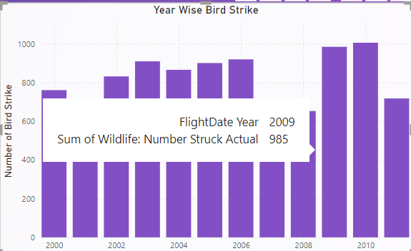
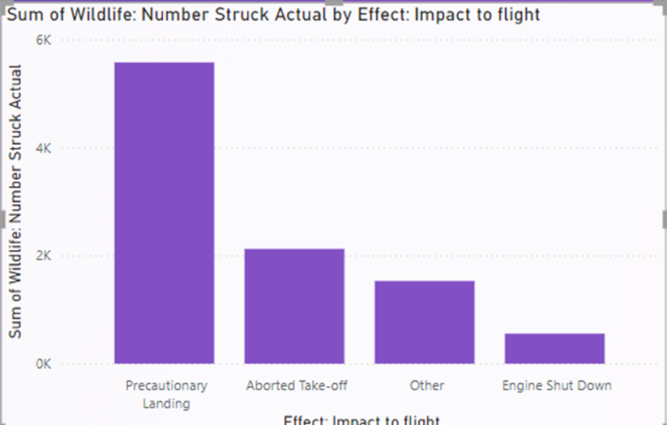
Data visualization of the case study

Slide 11
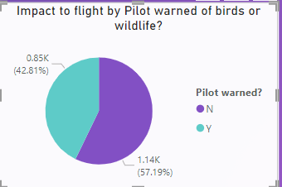
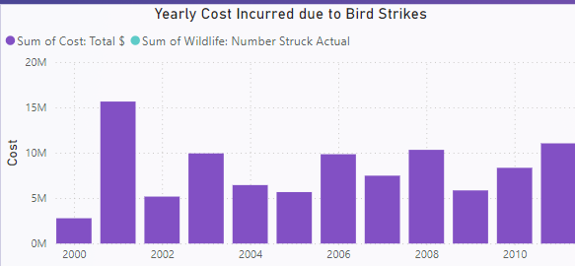
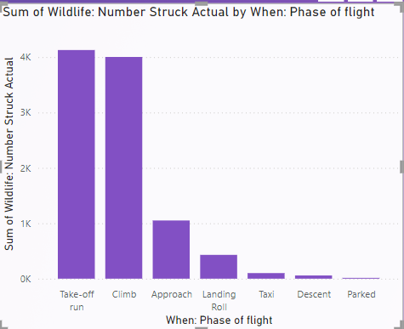
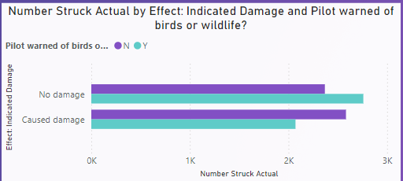
Case study

Slide 12
Prediction with model
Were Pilots Informed? & Prior Warning and Effect of Strike Relation
Model Type: Classification
Objective: Predict if a prior warning affects the impact of a bird strike.
Algorithm: Logistic Regression, Random Forest, Gradient Boosting
Features: Prior warning, altitude, phase of flight.
Target Variable: Impact on flight

Slide 13
Results
Training the Models
train three different models: Logistic Regression, Random Forest, and Gradient Boosting. After training, you will evaluate the models.
Expected Output for Model Training and Evaluation
The expected output during model training and evaluation is the accuracy score, classification report, and confusion matrix for each model.
Output :
Logistic Regression Accuracy: 0.6683417085427136
Random Forest Accuracy: 0.7261306532663316
Gradient Boosting Accuracy: 0.7211055276381909

Slide 14
Conclusion and future enchancement
The Random Forest model has the highest accuracy (0.7261), followed closely by the Gradient Boosting model (0.7211). Logistic Regression has the lowest accuracy (0.6683).
Random Forest: This model performs the best among the three, suggesting it is more capable of capturing the relationships between the features and the target variable. The ensemble nature of Random Forest helps in reducing overfitting and improving predictive performance.
Feature Engineering:
Additional Features: Incorporate more features that might influence the impact, such as weather conditions, bird species, time of day, and airport-specific data.
Interaction Features: Create interaction terms between existing features to capture more complex relationships.
Temporal Features: Add temporal features like month, season, or specific time windows when bird strikes are more likely.

Slide 15
Thank you

